Slide 1

Automated Guided Vehicle (AGV) Autonomous Mobile Robot (AMR)
Iqmal Hakimi Bin Razali
1912103

Slide 2
History of AGV
The first Automatic Guided Vehicle (AGV) was created by Barrett Electronics in the early 1950s. Barrett Electronics produced automated technology for the material handling business. These early AGVs were directed by floor-mounted cables or rails. They were created to move materials inside of warehouses and factories, increasing productivity and lowering labor expenses.
With the development of computer control systems in the 1960s, AGV technology advanced, enabling more accurate navigation and improved line-of-business equipment integration.
The advent of laser guidance technology in the 1980s made it possible for AGVs to traverse without the use of fixed pathways or guides. With the aid of this technology, AGVs could move more nimbly and adjust to shifting circumstances in a factory or warehouse.
AGV technology continued to advance in the 1990s with the development of vision systems, which allowed AGVs to maneuver more precisely in challenging situations and detect and avoid obstacles.

Slide 3
History of AMR
In the 1990s, military applications were the main focus of the early AMRs, which were utilized for activities including reconnaissance and surveillance.
The usage of AMRs started to spread into new sectors in the late 1990s and early 2000s, including manufacturing and logistics. These robots were created to operate in chaotic situations without established courses or cues. To map their surroundings and navigate on their own, they made use of sensors, cameras, and other technologies.
AMRs started to be employed in a broader number of industries in the 2010s, including as healthcare, hospitality, and retail. These robots were created to carry out a range of jobs, including refilling store shelves, delivering medication in hospitals, and providing room service in hotels.

Slide 4
Applications
Manufacturing: AGVs and AMRs are used to transport materials and components in factories, assembly lines, and warehouses. They are also used to automate processes such as part loading, unloading, and inspection.
Logistics and Warehousing: AGVs and AMRs are used to move goods and products within distribution centers, warehouses, and storage facilities. They are used for tasks such as picking, packing, and shipping, and can operate 24/7 without the need for breaks.
Healthcare: AMRs are used in hospitals and clinics to deliver medication and supplies to patients and staff. They can also transport medical equipment and specimens between different departments.
Retail: AMRs are used in retail environments to perform tasks such as restocking shelves, taking inventory, and delivering goods to customers.
Agriculture: AMRs are being developed for applications in farming and agriculture. They can be used for tasks such as harvesting crops, monitoring plant growth, and applying pesticides.
Mining: AMRs are being developed for use in mining operations. They can be used for tasks such as drilling, blasting, and transporting materials.
Hospitality: AMRs are being used in hotels and resorts for tasks such as delivering room service and transporting luggage.
Transportation: AGVs are used in transportation systems such as airports and train stations for tasks such as baggage handling and passenger transportation.

Slide 5
Main Components
Design
Propulsion System
Navigation System & Control
Data Collection
Data Transmission
Power Management

Slide 6
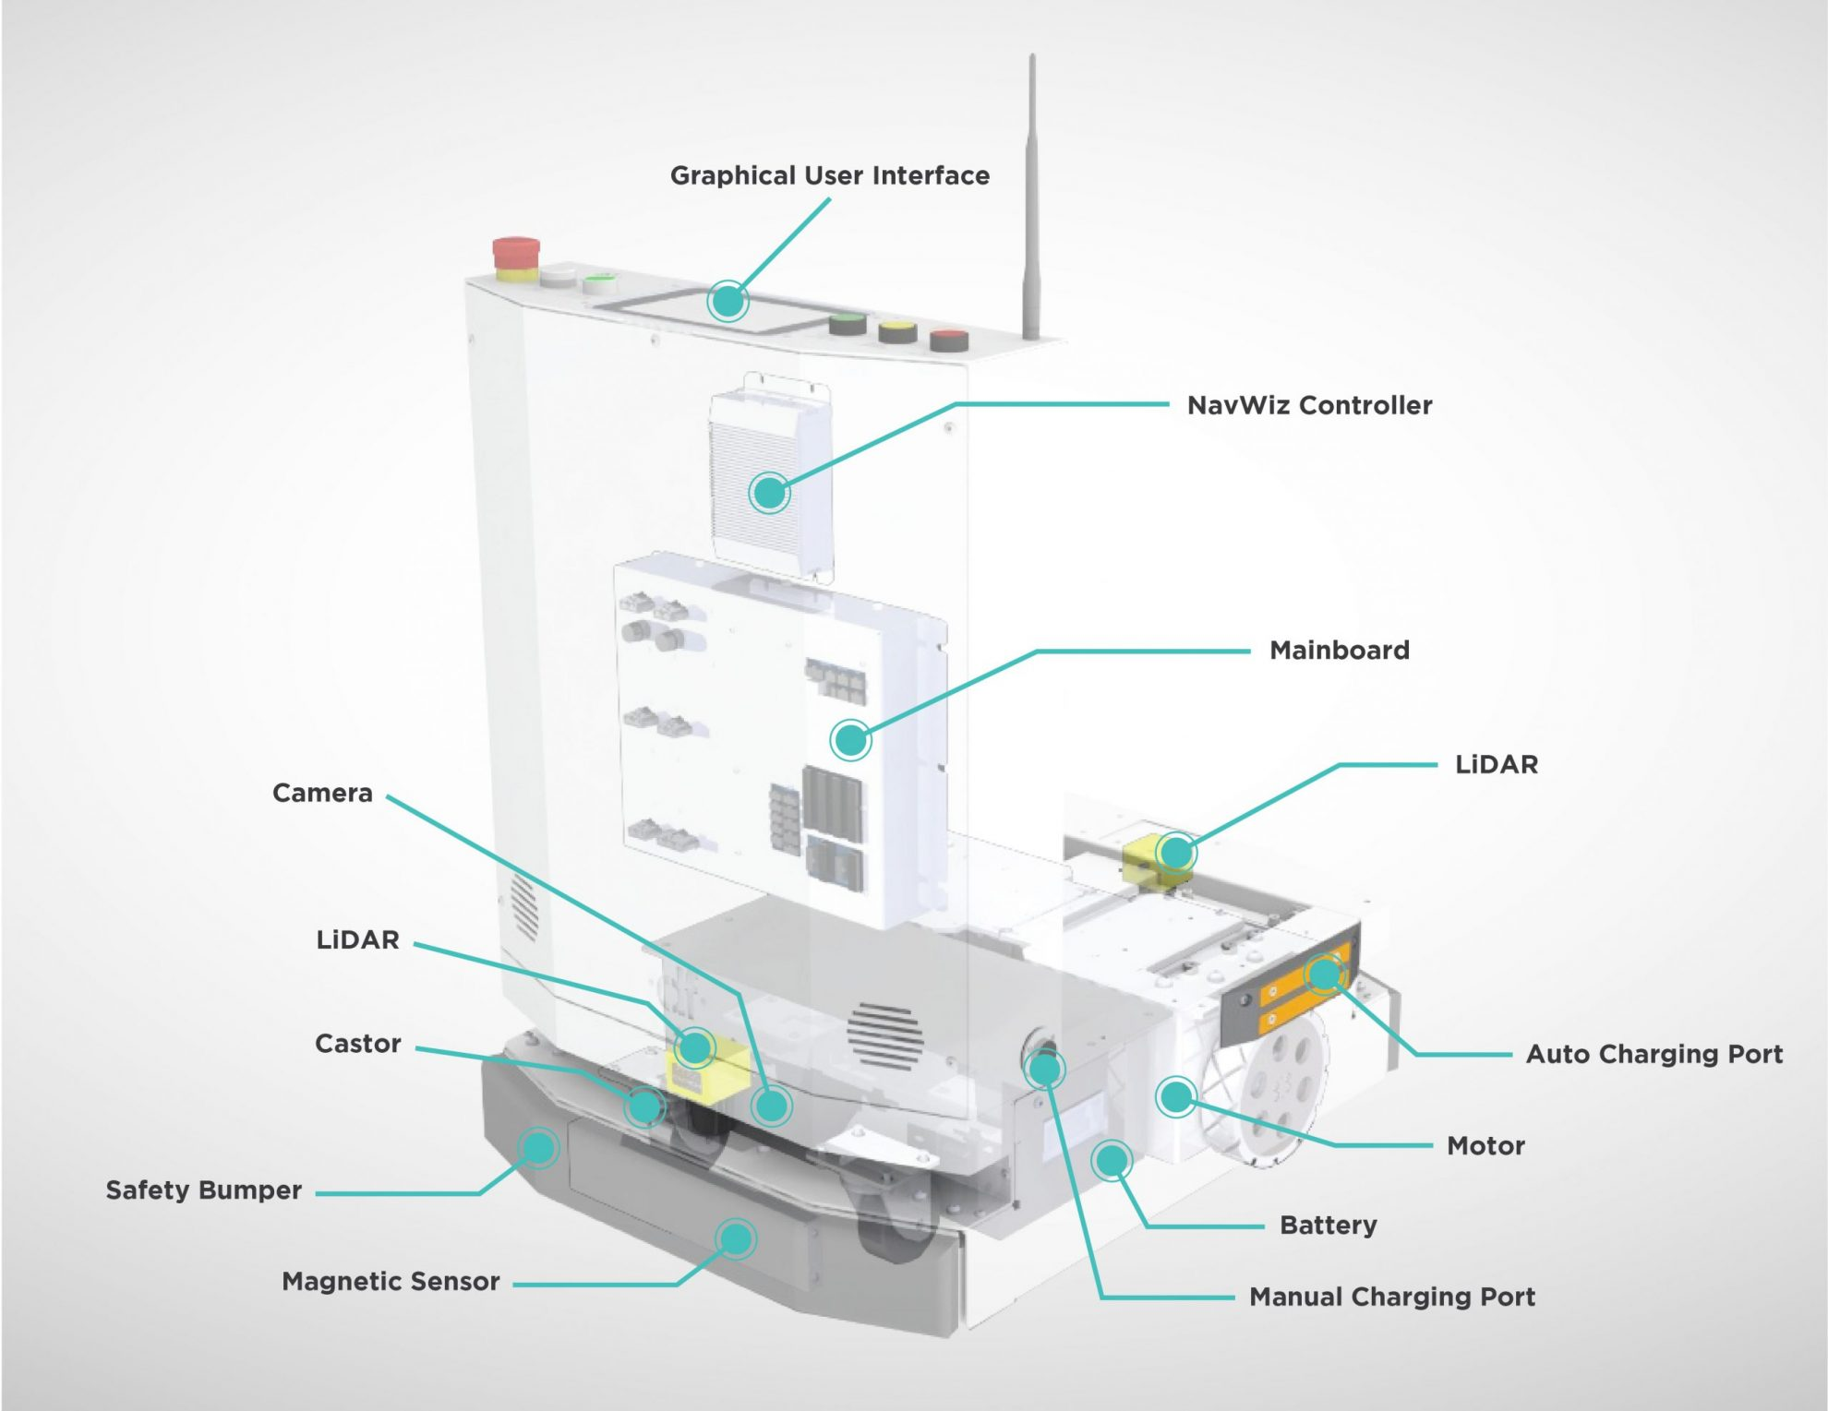
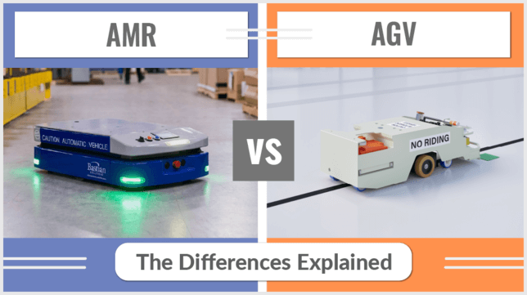
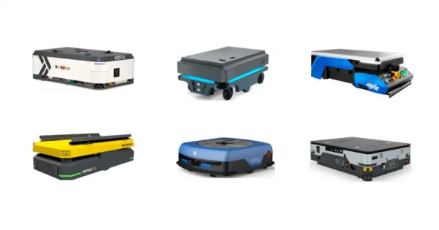
Design of AGV/AMR

Slide 7
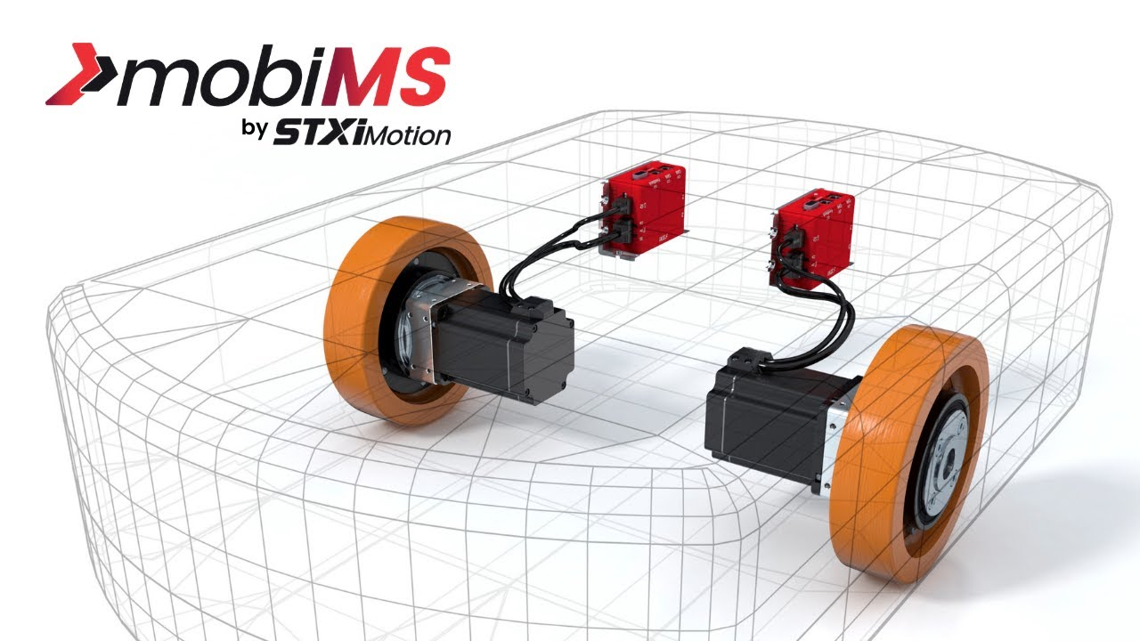
Propulsion System
Wheel-based: This is the most common type of propulsion system used in AGVs and AMRs. The vehicles are equipped with wheels or tracks that allow them to move on a flat surface. They can be powered by electric motors or hydraulic systems.
Magnetic: Some AGVs and AMRs use magnetic propulsion systems. These systems use a magnetic field to propel the vehicle forward, rather than wheels or tracks. They are commonly used in applications such as semiconductor manufacturing, where cleanliness is critical.
Air-based: AGVs and AMRs can also be propelled by air systems. These systems use compressed air to move the vehicle forward. They are typically used in cleanroom environments or other applications where a non-contact propulsion system is needed.
Legged: Some AMRs use legged propulsion systems that mimic the movement of animals or insects. These systems are still in development and are not yet widely used in commercial applications.

Slide 8
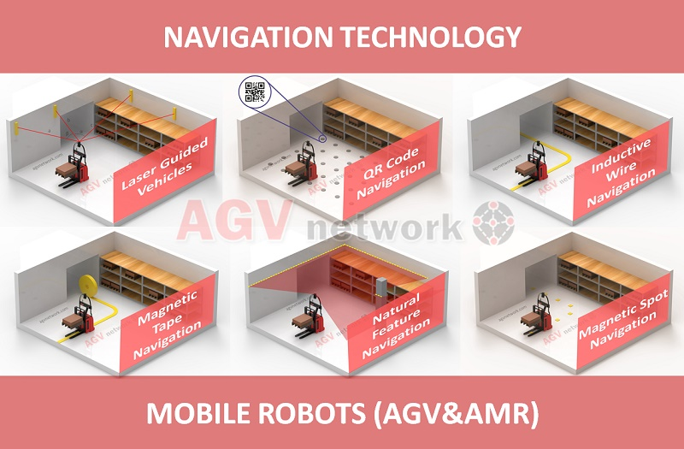
Navigation System & Control
Laser-based navigation: This is one of the most common navigation systems used in AGVs and AMRs. It uses a laser scanner or LIDAR to create a map of the environment, and then the vehicle uses this map to navigate autonomously.
Magnetic tape guidance: Some AGVs use magnetic tape on the floor to guide their movements. The vehicle is equipped with sensors that detect the magnetic field created by the tape and use this information to follow a predetermined path.
Vision-based navigation: Some AGVs and AMRs use cameras or other vision-based sensors to navigate autonomously. These systems use computer vision algorithms to interpret the environment and determine the vehicle's position and orientation.
Inertial navigation: Some AGVs use inertial navigation systems that use sensors to detect changes in the vehicle's position and orientation. These systems can be used in environments where other navigation systems may not be effective, such as underground mines or warehouses with tall shelving.
Control methods: AGVs and AMRs can be controlled using various methods, including central control systems, decentralized control systems, and hybrid control systems. Central control systems use a centralized computer to control multiple vehicles, while decentralized systems use onboard controllers to control individual vehicles. Hybrid systems combine elements of both central and decentralized control.

Slide 9
Data Collection
Barcode or RFID readers: AGVs and AMRs can be equipped with barcode or RFID readers that allow them to collect data from items or locations in the environment. This data can be used to track inventory, monitor production processes, or guide the vehicle's movements.
Cameras and sensors: AGVs and AMRs can also be equipped with cameras and sensors that allow them to collect data about their environment. This data can be used for navigation, obstacle detection, and quality control.
Environmental sensors: AGVs and AMRs can be equipped with environmental sensors that monitor temperature, humidity, and other environmental factors. This data can be used to ensure that products are stored or transported under the correct conditions.
GPS and location tracking: Some AGVs and AMRs are equipped with GPS and location tracking systems that allow them to track their position and movements in real-time. This data can be used for navigation, inventory tracking, and quality control.
Control system data: AGVs and AMRs are often controlled by central or decentralized control systems, which can collect data on the vehicle's movements, battery life, and other performance metrics. This data can be used for maintenance and performance optimization.

Slide 10
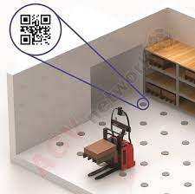

Slide 11
Data Transmission
Wi-Fi: AGVs and AMRs can use Wi-Fi networks to transmit data to and from central control systems. This allows for real-time tracking and monitoring of the vehicle's movements and performance.
Bluetooth: AGVs and AMRs can also use Bluetooth technology to communicate with other devices in the environment, such as sensors or handheld devices used by operators.
Cellular: Some AGVs and AMRs are equipped with cellular modems that allow them to communicate with remote control systems or cloud-based platforms. This enables real-time monitoring and management of the vehicles from anywhere in the world.
Ethernet: AGVs and AMRs can also use Ethernet networks to transmit data to and from control systems. This is commonly used in industrial settings where wired networks are already in place.
Proprietary communication protocols: Some AGVs and AMRs use proprietary communication protocols developed by the manufacturer. These protocols are designed to be optimized for the specific needs of the application and can provide enhanced performance and reliability.

Slide 12
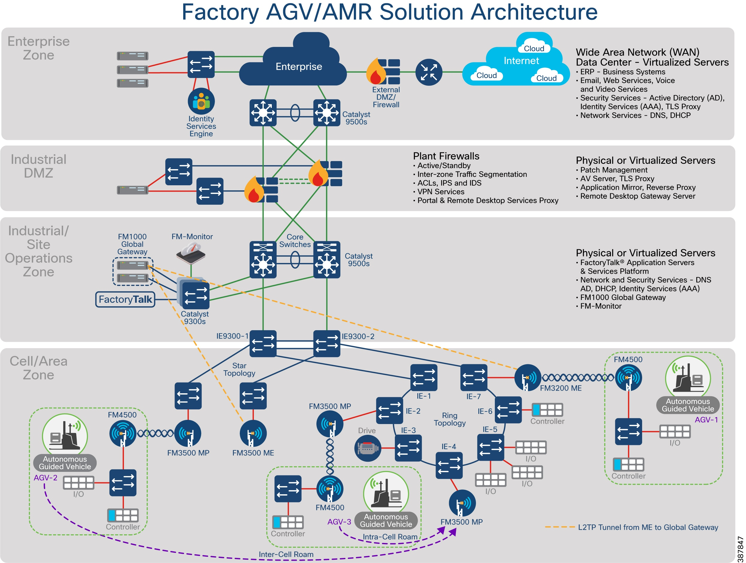
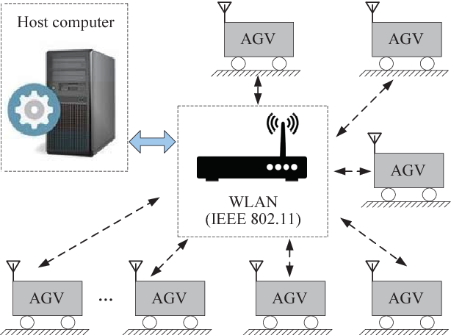
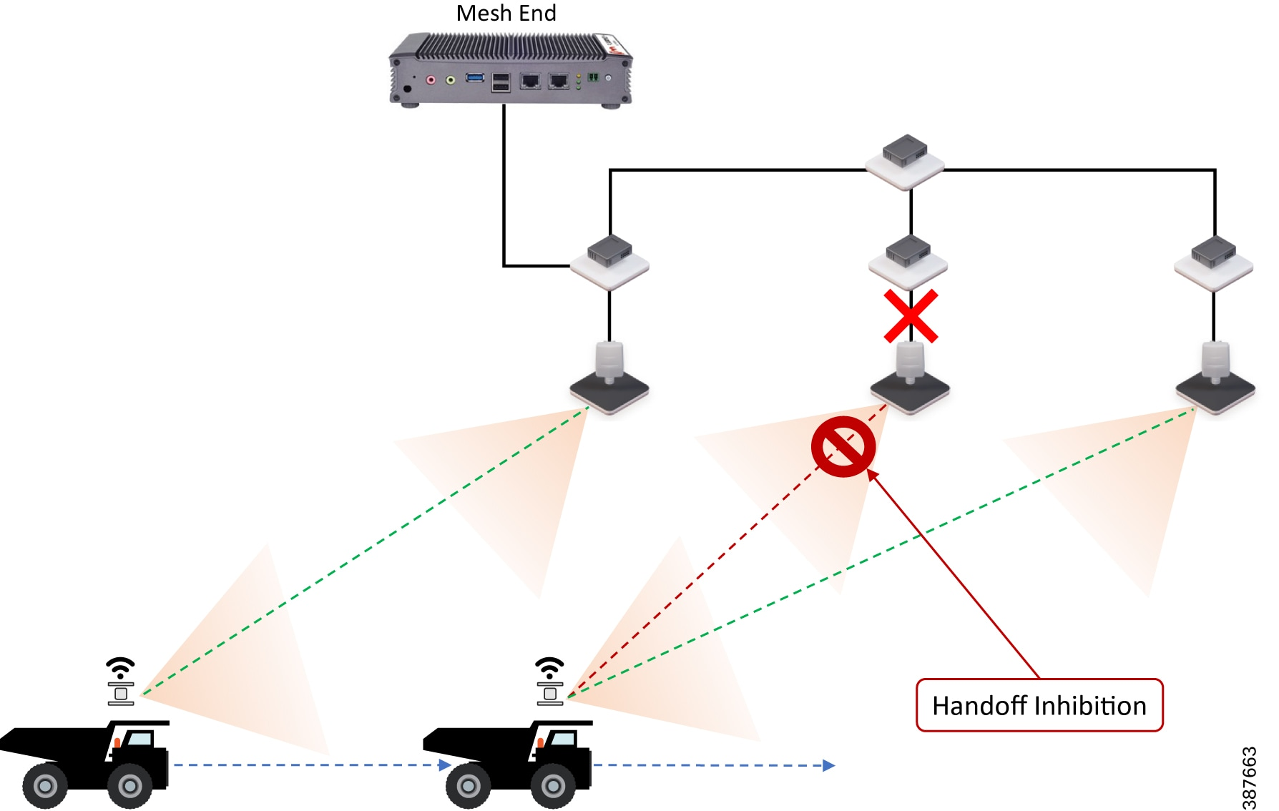

Slide 13
Power Management
Lead-acid batteries: Lead-acid batteries are one of the most common types of batteries used in AGVs and AMRs. They are relatively inexpensive and can provide a high-power output for a short period of time. However, they have a relatively short lifespan and require frequent maintenance.
Lithium-ion batteries: Lithium-ion batteries are becoming increasingly popular in AGVs and AMRs due to their high energy density, long lifespan, and low maintenance requirements. They are also lighter and more compact than lead-acid batteries, which can improve vehicle performance.
Nickel-metal hydride batteries: Nickel-metal hydride batteries are another type of rechargeable battery that can be used in AGVs and AMRs. They have a longer lifespan than lead-acid batteries and are less prone to memory effect, but they are less energy-dense than lithium-ion batteries.
Fuel cells: Some AGVs and AMRs use fuel cells as a power source. Fuel cells generate electricity by combining hydrogen and oxygen and produce only water as a byproduct. Fuel cells are efficient and produce zero emissions, but they are still relatively expensive and require infrastructure for hydrogen storage and distribution.

